Slide 1
DOG ADOPTION DECENTRALIZED APPLICATION USING BLOCKCHAIN
PRITI PANDEY(18BCS3290)
KASHISH KUMAR(18BCS3171)
ANIL THAKUR(18BCS3150)
ANIKET SINGH(18BCS3155)

Slide 2
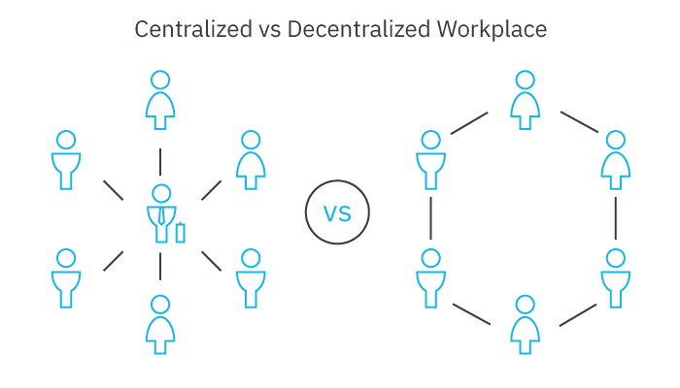
Decentralized application:
Decentralized applications (DApps) are digital applications or programs that exist and run on a blockchain or P2P network of computers instead of a single computer, and are outside the purview and control of a single authority.
DApps can run on a P2P network or a blockchain network. For example, BitTorrent, Tor and Popcorn Time

Slide 3
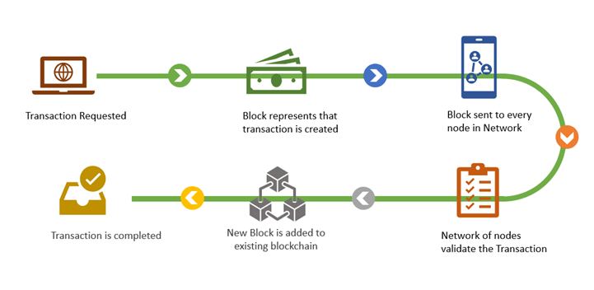
Blockchain Key elements of a blockchain Distributed ledger technology Immutable records Smart contracts
Blockchain is a shared, immutable ledger that facilitates the process of recording transactions and tracking assets in a business network. An asset can be tangible (a house, car, cash, land) or intangible (intellectual property, patents, copyrights, branding). Virtually anything of value can be tracked and traded on a blockchain network, reducing risk and cutting costs for all involved.
Blockchain consists of three important concepts: blocks, nodes and miners.

Slide 4
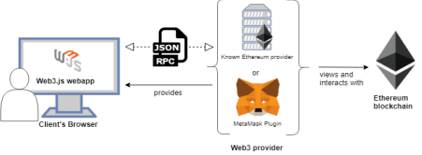
Ethereum Blockchain
In late 2013, Russian-Canadian developer Vitalik Buterin published a white paper that proposed a platform combining traditional blockchain functionality with one key difference: the execution of computer code. Thus, the Ethereum Project was born.

Slide 5
Modules:
1. Backend (Creating a Truffle project using a Truffle Box)
Will be working with truffle and Writing the smart contract
2. Migration
In this module the smart contracts will be compiled and migrated to Ganache, a personal blockchain for Ethereum development.
3. Frontend (Interacting with the dapp in a browser)
In this module we will be creating user-interface to interact with the contracts made in the backend module of the project.
Software’s to install:
● Node.js ● Ganache ● Truffle ● Metamask

Slide 6
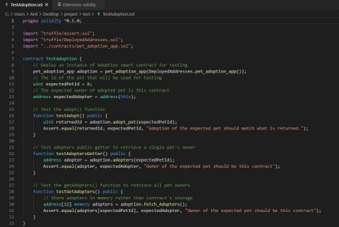
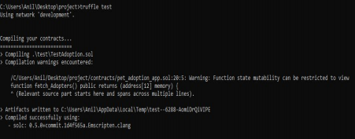
Test case: Truffle is very flexible when it comes to smart contract testing, we will be testing our contract using Solidity. Below is test file named as TestAdoption.sol

Slide 7
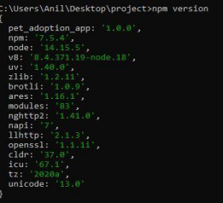

BACKEND: At the backend we will begin by setting up the development environment and installing necessary software tools. We have installed Node.js and on node.js command line we will be running all our commands. Setting up the development environment:

Slide 8
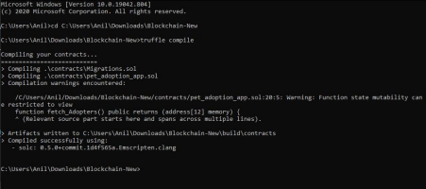
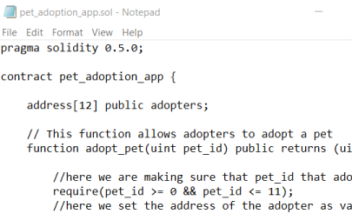
Writing the smart contract:

Slide 9
THANK YOU

